Slide 1
Unit - 1
OOP Paradigm
Java basics
Introducing classes and objects

Slide 2
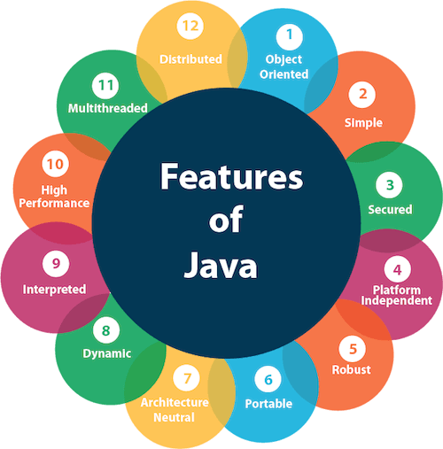
Features of Java

Slide 3
Simple
Java is very easy to learn, and its syntax is simple, clean and easy to understand. According to Sun, Java language is a simple programming language because:
Java syntax is based on C++ (so easier for programmers to learn it after C++).
Java has removed many complicated and rarely-used features, for example, explicit pointers, operator overloading, etc.
There is no need to remove unreferenced objects because there is an Automatic Garbage Collection in Java.

Slide 4
Object-oriented
Java is an object-oriented programming language. Everything in Java is an object. Object-oriented means we organize our software as a combination of different types of objects that incorporates both data and behavior.
Object-oriented programming (OOPs) is a methodology that simplifies software development and maintenance by providing some rules.
Basic concepts of OOPs are:
Object
Class
Inheritance
Polymorphism
Abstraction
Encapsulation

Slide 5
Platform Independent
Java code can be run on multiple platforms, for example, Windows, Linux, Sun Solaris, Mac/OS, etc.
Java code is compiled by the compiler and converted into bytecode.
This bytecode is a platform-independent code because it can be run on multiple platforms, i.e., Write Once and Run Anywhere(WORA).

Slide 6
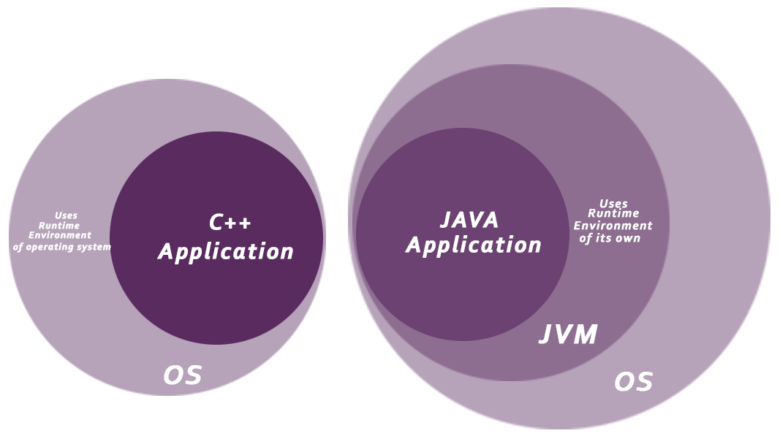
Secured
Java is best known for its security. With Java, we can develop virus-free systems. Java is secured because:
No explicit pointer
Java Programs run inside a virtual machine sandbox

Slide 7
Robust
Robust simply means strong. Java is robust because:
It uses strong memory management.
There is a lack of pointers that avoids security problems.
There is automatic garbage collection in java which runs on the Java Virtual Machine to get rid of objects which are not being used by a Java application anymore.
There are exception handling and the type checking mechanism in Java. All these points make Java robust.

Slide 8
Platform Independent and Portable
The Java compiler generates an architecture-neutral object file meaning that compiled Java code (bytecode) can run on many processors given the presence of a Java runtime.
Java is portable because there are no implementation-dependent aspects of the specification.
For instance in C++ an int can be 16-bit, or 32 bit depending on who is implementing the specification where as in Java an int is always 32 bit.

Slide 9
Platform Independent and Portable
greetings.c
#include <stdio.h>
main()
{
int a = 10;
printf("Hello, World!");
}
greetings.exe
a.out
Portability is a source code idea, while architectural neutrality is an executable idea.

Slide 10
Platform Independent and Portable
JAVA COMPILER
(translator)
JAVA BYTE CODE
(same for all platforms)
JAVA INTERPRETER
(one for each different system)
Windows
Macintosh
Solaris
Linux

Slide 11
High Performance
Java is an interpreted language. Hence it is slower than compiled languages, e.g., C, C++, etc.
The key of java power "Write once, run everywhere" is bytecode.
These bytecode can be interpreted or compiled to native code.
Interpreting the bytecode which is the standard implementation of the Java Virtual Machine (JVM) makes execution of programs slow.
However, JIT (Just-In-Time) compiler which is part of the JRE (Java Runtime Environment) interacts with the JVM at run time and compiles appropriate bytecode sequences into native machine code.
Invocation count threshold reaches 0, JIT comes into action!

Slide 12
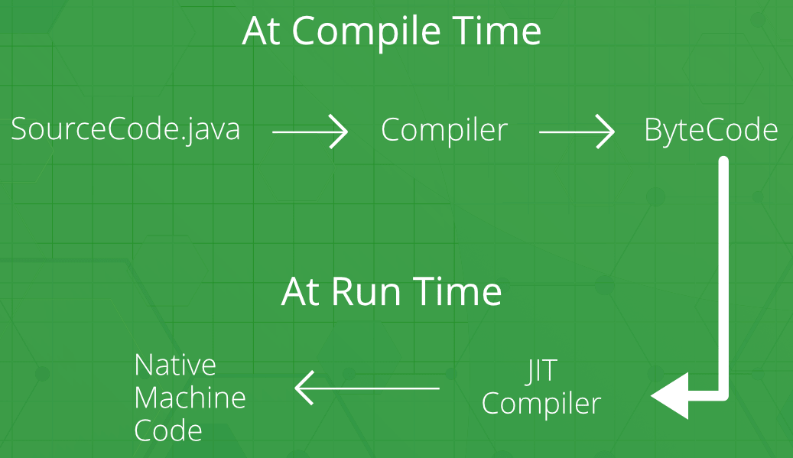
High Performance
Note: The time that a JIT compiler takes to compile the bytecode is added to the overall execution time, and could lead to a higher execution time than an interpreter for executing the bytecode if the methods that are compiled by the JIT are not invoked frequently.

Slide 13
Distributed
Java is distributed because it facilitates users to create distributed applications in Java.
RMI (Remote Method Invocation) and EJB (Enterprise JavaBeans) are used for creating distributed applications.
Also, support for TCP, UDP, and basic Socket communication is excellent. We can develop networked applications using Java.
This feature of Java makes us able to access files by calling the methods from any machine on the internet.

Slide 14

Multithreaded
A thread is like a separate program, executing concurrently.
We can write Java programs that deal with many tasks at once by defining multiple threads.
Useful in developing Web browsers, Web servers, Banking Applications, Computer games (Bike Racing!)
Is Microsoft Word a multithreaded application?

Slide 15
Dynamic
Java is a dynamic language. It supports dynamic loading of classes. It means classes are loaded on demand.
It also supports functions from its native languages, i.e., C and C++.
Java supports dynamic compilation and automatic memory management (garbage collection).

Slide 16
Key Attributes of OO Programming
Encapsulation
Binds together code and the data it manipulates, and keeps both safe from outside interference and misuse. (Black box)
When code and data are linked together, an object is created. In other words, an object is the device that supports encapsulation.
Within the object, code, data or both may be private to that object or public.
Java’s basic unit of encapsulation is the class.
A class specifies both the data and the code that will operate on that data. Objects are instances of a class.
The code and data that constitute a class are called members of the class.
Data defined by the class are called member variables or instance variables. (They are usually private. Only methods can access them)
Code that operates on the data are called methods. (They are usually public)

Slide 17
Key Attributes of OO Programming
Polymorphism
A quality that allows one interface to access a general class of actions. The specific action is determined by the exact nature of the situation.
Example: open() operation
One interface, multiple methods: A generic interface to a group of related activities
Helps in reducing complexity by allowing the same interface to be used to specify a general class of action.
Compiler selects the specific action (i.e, method) as it applied to each situation.

Slide 18
Key Attributes of OO Programming
Inheritance
A process by which one object can acquire the properties of another object.
Inheritance supports hierarchical classification.
Bike → two wheeler → Vehicle
Without hierarchy, each object would have to explicitly define all of its characteristics.
Using inheritance, an object need only define those qualities that make it unique within its class.
It can inherit its general attributes from its parent.
Generalization to specialization

Slide 19
The Java Development Kit (JDK)
Download at https://www.oracle.com/technetwork/java/javase/downloads/index.html
The JDK runs in the command prompt environment. It is not a windowed application and also not an integrated development environment (IDE)
NetBeans IDE
A fast fully-featured Integrated Development Environment (IDE) with support for Java

Slide 20
Step 1:
Write source code
Editor
Source Code: Test.java
Step 2:
Compile (Translate) source code to byte code
Java Compiler
javac Test.java
Byte Code: Test.class
Step 3:
Execute (Run) the byte code
Input
Java Runtime
java Test
Output

Slide 21
Arrays
An array is a collection of variables of the same type, referred to by a common name.
Arrays offer a convenient means of grouping together related variables.
A one-dimensional array is a list of related variables.
Since arrays are implemented as objects, creation of an array is a two-step process.
Declare an array reference variable.
Allocate memory for the array, assigning the reference to that memory to the array variable.
Thus arrays in Java are dynamically allocated using the new operator.
type[] array_name;
array_name = new type[size] OR
type[] array_name = new type[size];
Example:
int[] marks;
marks = new int[60]; OR
int[] marks = new int[60];

Slide 22
An individual element within the array is accessed by use of an index that starts from 0 and ranges up to size-1.
class ArrayDemo {
public static void main(String args[]) {
int a[] = new int[10], i;
for(i=0; i<1; i++)
a[i] = i * 2;
for(i=0; i<10; i++)
System.out.println(a[i]);
}
}

Slide 23
Arrays can be initialized when they are declared.
type[] array_name = { val1, val2, …., valN };
Java automatically allocates an array large enough to hold the initializers that you specify. There is no need to explicitly use the new operator.
Array boundaries are strictly enforced in Java. It is a runtime error to overrun or underrun the end of an array.
If you try to, then you get an exception (a runtime error): ArrayIndexOutOfBoundsException and the program is terminated.

Slide 24
package Bubble;
class Bubble {
public static void main(String args[]) {
int[] a = {12, 7, 34, 25, -6, 4, 19, 9, 312, 5};
int i, j, temp, size = 10;
System.out.println(“Original array:”);
for(i=0; i<size; i++)
System.out.println(“ “ + a[i]);
for(i=0; i<size-1; i++)
for(j=0; j<size-i-1; j++)
if(a[j] > a[j+1]) {
temp = a[j];
a[j] = a[j+1];
a[j+1] = templ
}
System.out.println(“Sorted array:”);
for(i=0; i<size; i++)
System.out.println(“ “ + a[i]);
}
}

Slide 25
Multidimensional Arrays
In Java, a multidimensional array is an array of arrays.
The simplest form of multidimensional array is two-dimensional array (essentially a list of one-dimensional arrays).
A two-dimensional array can be thought of as creating a table of data, with the data organized by row and column.
To declare a two-dimensional array, you need to specify the size of both dimensions.
int [][] matrix = new int [10][20];

Slide 26
Irregular or Jagged Arrays
When you allocate memory for a multidimensional array, you need to specify only the memory for the first dimension. You can allocate the remaining dimensions separately.
int [][] matrix = new int [3][];
matrix[0] = new int[4];
matrix[1] = new int[4];
matrix[2] = new int[4];
The above declarations can be done using a single statement!!
int [][] matrix = new int[3][4].
However, as multidimensional arrays are implemented as arrays of arrays, the length of each array is under your control.
Jagged array is array of arrays such that member arrays can be of different sizes, i.e., we can create a 2-D arrays but with variable number of columns in each row. These type of arrays are also known as Irregular arrays.

Slide 27
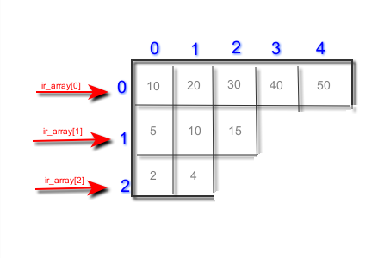
double[][] ir_array = new double [3][];
ir_array[0] = new double[5];
ir_array[1] = new double[3];
ir_array[2] = new double[2];
for (int i = 0; i < 5; i++) {
ir_array[0][i] = (i + 1) * 10;
}
for (int i = 0; i < 3; i++) {
ir_array[1][i] = (i + 1) * 5;
}
for (int i = 0; i < 2; i++) {
ir_array[2][i] = (i + 1) * 2;
}

Slide 28
Java allows arrays with more than two dimensions. The general form of a multidimensional array declaration is:
type[][]…[] name = new type[size1][size2]….[sizeN];
A multidimensional array can be initialized by enclosing each dimension’s initializer list within its own set of braces. The general form is:
type[][] array_name = {
{val, val, val, …. val},
{val, val, val, …. val},
…
…
{val, val, val, …. val}
};

Slide 29
Alternative Array Declaration Syntax
There is a second form that can be used to declare an array:
type var_name[];
Following two declarations are equivalent.
int [] counter = new int[3];
int counter[] = new int[3];
The following two declarations are equivalent.
char [][] table = new char[3][4];
char table[][] = new char[3][4];
The second form allows us to declare both array and nonarray variables of the same type in a single declaration.
int[] a = {12, 7, 34, 25, 9, 312, 5}, i, j, temp, size = 10; //WRONG
int a[] = {12, 7, 34, 25, 9, 312, 5}, i, j, temp, size = 10;

Slide 30
Assigning Array References
We can assign one array reference variable to another. This simply changes what object that variable refers to. Note that it does not result in copy of the array being created.
int[] num1 = {1,2,3,4,5};
int[] num2 = {6,7,8,9};
num2 = num1;
num2[3] = 10;
1
2
3
4
5
6
7
8
9
10
num1
1
2
3
10
5
num2

Slide 31
Using the length member
Arrays are implemented as objects. Each array has an associated instance variable called length that contains the number of elements that the array can hold (i.e., length contains the size of the arrays).
int[] list = new int[10];
int[] nums = {1,2,3,4,5};
int[][] table = { {1,2,3}, {4,5}, {6,7,8,9} };
list.length → 10
nums.length → 5
table.length → 3
table[0].length → 3
table[1].length → 2
table[2].length → 4
Note that the value of length has nothing to do with the number of elements that are actually in use.

Slide 32
class ArrayCopy {
public static void main(String args[]) {
int[] num1 = new int[10];
int[] num2 = new int[10];
for(int i=0; i< num1.length; i++) {
num1[i] = i;
//Copt num1 to num2
if(num2.length >= num1.length)
for(i=0; i<num1.length; i++) //Anything wrong here?
num2[i] = num1[i];
System.out.println(“Copied array is…”);
for(i=0; i<num2.length; i++) //Anything wrong here??
System.out.println(num2[i] + “ “);
}
}
The instance variable length is used to confirm that the target array is large enough to hold contents of the source array.
The instance variable length provides the terminating condition of the for loop that performs the copy.
length is read-only. You cannot assign it a new value. This means that you cannot change the array size by changing the value of length.

Slide 33
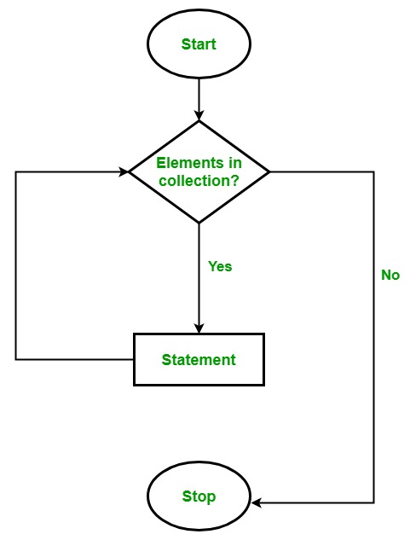
The for-each loop
To iterate through the array elements, we use the for loop. The iteration is required to perform tasks such as computing average, searching for a value, copying an array and so on.
Java defines another form of for loop called “for-each” style loop for such “start-to-finish” iterations.
The general form of the for-each style for is:
for(type item : collection)
statement_block

Slide 34
For each iteration, the for-each loop
iterates through each item in the given collection or array,
stores each item in a variable (item)
and executes the body of the loop.
char[] vowels = {'a', 'e', 'i', 'o', 'u'};
for (int i = 0; i < vowels.length; i++)
System.out.println(vowels[i]);
is same as….
char[] vowels = {'a', 'e', 'i', 'o', 'u'};
for (char item: vowels)
System.out.println(item);

Slide 35
class EnhancedForLoop {
public static void main(String[] args) {
int numbers[] = {3, 4, 5, -5, 0, 12}, sum=0;
for (int number : numbers)
sum += number;
System.out.println("Sum = " + sum);
}
}
Note: If you change the value of number,
it does not affect the numbers collection.
Iteration | Value of number | Value of sum
1 | 3 | 3
2 | 4 | 7
3 | 5 | 12
4 | -5 | 7
5 | 0 | 7
6 | 12 | 19

Slide 36
Example: Linear Search
public class ForEachExample {
public static void main(String args[]) {
int [] a = {6,3,5,9,12,4,8};
int key = 41;
boolean found = false;
for(int x : a) {
if(x == key) {
found = true;
break;
}
}
if(found)
System.out.println("Key found in the list");
else
System.out.println("Key not found in the list");
}
}

Slide 37
Iterating Over Multidimensional Arrays
In Java, multidimensional arrays are arrays of arrays.
A two-dimensional arrays is an array of one-dimensional arrays.
Hence, the iteration variable must be a reference to a one-dimensional array.
In general, when using the for-each to iterate over an array of N dimensions, the objects obtained will be arrays of N-1 dimensions.

Slide 38
class ForEachExample {
public static void main(String args[]) {
int sum = 0;
int [][] a = new int [3][5];
// Assign some values into array a
for(int i=0; i<3; i++)
for(int j=0; j<5; j++)
a[i][j] = (i + 1) * (j + 1);
for(int [] b : a) {
for(int m : b) {
System.out.println(m + “\t”);
sum += m;
}
System.out.println();
}
System.out.println(“Sum is “ + sum);
}
}
run:
1 2 3 4 5
2 4 6 8 10
3 6 9 12 15
Sum is 90

Slide 39
Strings
One of the most important data types in Java is String.
String defines and supports character strings.
String is an object in Java, not an array of characters.
We use new and call the String constructor.
String str1 = new String(“Hello”);
We can construct a string from another string.
String str2 = new String(str1);
Another way of creating strings is to provide the string literal:
String str3 = “Java Strings are powerful!”;

Slide 40
Operations on Strings
Method Name | Description
char charAt(index) | returns char value for the particular index
int length() | returns string length
boolean equals(str) | Returns true if the invoking string contains the same character sequence as str
int indexOf(str) | Searches the invoking string for the substring specified by str. Returns the index of the first match or -1 on failure
Int lastIndexOf(str) | Searches the invoking string for the substring specified by str. Returns the index of the last match or -1 on failure
int compareTo(str) | Returns less than zero if the invoking string is less than str, greater than zero if the invoking string is greater than str, and zero if the strings are equal.

Slide 41
length()
public class Example{
public static void main(String args[]{
String s1="hello";
String s2="whatsup";
System.out.println("string length is: "+s1.length());
System.out.println("string length is: "+s2.length());
}
}
Output:
Displays the length 5 for s1 and 7 for s2 respectively

Slide 42
compareTo()
public class CompareToExample{
public static void main(String args[]){
String s1="hello";
String s2="hello";
String s3="hemlo";
String s4="flag";
System.out.println(s1.compareTo(s2)); // 0 because both are equal
System.out.println(s1.compareTo(s3)); //-1 because "l" is lesser than "m"
System.out.println(s1.compareTo(s4)); // 2 because "h" is greater than "f"
}
}

Slide 43
equals()
public class EqualsExample{
public static void main(String args[]){
String s1="hello";
String s2="hello";
String s3="hi";
String s4 = “HELLO”;
System.out.println(s1.equals (s2)); // returns true
System.out.println(s1.equals(s3)); // returns false
System.out.println(s1.equalsIgnoreCase(s4)); // returns true
}
}
// String s2 = new String(“hello”); s1.equals(s2) ??? (s1 == s2) ???
Note: equals() method compares the character sequence of two string objects for equality. Applying the == to two string references simply determines whether the two references refer to the same object.

Slide 44
indexOf()
public class IndexOfExample{
public static void main(String args[]){
String s1="this is index of example";
int index1=s1.indexOf("is");//returns the index of // ‘is’ substring
int index2=s1.indexOf("index");//returns the index of // ’index’ substring
System.out.println(index1 + " " + index2); //2 8
}
}

Slide 45
lastIndexOf()
public class LastIndexOfExample3 {
public static void main(String[] args) {
String str = “Welcome to home sweet home";
int index = str.lastIndexOf("of");
System.out.println(index); // 22
}
}

Slide 46
Array of Strings
Like any other data type, strings can be assembled into arrays.
Example
String [] strings = {“This”, “is”, “a”, “Java”, “class”};
for(String s : strings) // Output: This is a Java class
System.out.println(s + “ “);
strings[1] = “was”;
strings[2] = “not a”;
for(String s : strings) // Output: This was not a Java class
System.out.println(s + “ “);

Slide 47
Strings are immutable
Once created, the character sequence that makes up the string cannot be altered.
When you need a string that is a variation on one that already exists, simply create a new string that contains the desired changes.
Note, however, that a String reference variable may, of course, be assigned a reference to a different String object.
Immutability of strings is not a hindrance as the next example shows.

Slide 48
public class SubStr {
public static void main(String args[]) {
String s1 = “Java makes the web move.”;
String s2 = s1.substring(5, 18);
System.out.println(“Original string: “ + s1);
System.out.println(“Substring: “ + s2);
}
}
Note that the string s1 is unchanged, and s2 contains the substring.

Slide 49
Using a String to Control a switch Statement
Prior to JDK 7, a switch had to be controlled by an integer type, such as int or char.
In order to perform one of several actions based on the contents of a string, we had to make use of if-else-if ladder.
However, the use of switch statement would be more natural choice for such a selection.
Beginning with JDK 7, we can use String to control a switch.

Slide 50
String command = “Cancel”;
switch(command)
{
case “Connect”:
System.out.println(“Connecting…”); break;
case “Cancel”:
System.out.println(“Canceling…”); break;
case “Disconnect”:
System.out.println(“Disconnecting…”); break;
default:
System.out.println(“Command Error!”); break;
}

Slide 51
Using Command-Line Arguments
The java command-line argument is an argument i.e. passed at the time of running the java program.
The arguments passed from the console can be received in the java program and can be used as an input.
The command-line arguments are stored as strings in the String array passed to main().
Command Line Arguments can be used to specify configuration information while launching your application.
There is no restriction on the number of java command line arguments. You can specify any number of arguments.
Information is passed as Strings.

Slide 52
Program to add command line arguments
public class Add {
public static void main(String args[]) {
System.out.println(“Arguments are…”);
for(int i=0; i<args.length; i++)
System.out.println(args[i]);
System.out.println(“Result after adding them:”);
int sum = args[0] + args[1] + args[2];
System.out.println(sum);
}
}

Slide 53
Class Fundamentals
A class is a template that defines the form of an object.
It specifies both data and the code that will operate on that data.
Java uses a class specification to construct objects.
Objects are instances of a class.
A class is a logical abstraction. A physical representation of that class exists in memory only when you create an object of that class.
A well-designed class groups logically connected information. (A well-designed class should define one and only one logical entity).
A class is a description of a kind of thing. An object is an actual thing.

Slide 54
Stack Implementation in C
struct stack
{
int stk[MAXSIZE];
int top;
};
typedef struct stack STACK;
STACK s;
void push(void);
int pop(void);
void display(void)
int isFull(void);
int isEmpty(void);
int peek(void);

Slide 55
General Form of a Class
class classname {
// declare instance variables
type var1;
type var2;
// ….
type varN;
// declare methods
type method1(parameters) {
// body of method
}
type method2(parameters) {
// body of method
}
// …
type methodN(parameters) {
// body of method
}
}

Slide 56
Defining a Class
class Student {
String name;
int rollno;
int marks1, marks2, marks3;
}
class StudentDemo {
public static void main(String args[]) {
Student s1 = new Student();
double avg;
s1.name = "Shrinivas";
s1.rollno = 10;
s1.marks1= 24;
s1.marks2= 23;
s1.marks3= 25;
avg = (s1.marks1 + s1.marks2 + s1.marks3) / 3.0;
System.out.println("Student " + s1.name + " with roll number “ + s1.rollno + " has scored " + avg + " in CIE.");
}
}

Slide 57
Defining a Class
class Circle {
float radius;
Circle() { // Parameterless Constructor
radius = 5.0f;
}
Circle(float rad) { // Parameterized Constructor
radius = rad;
}
float computeArea() {
return(Math.PI * radius * radius);
}
}

Slide 58
Each object has its own copy of the instance variables defined by its class.
Thus, the contents of the variables in one object (called the state of the object) can differ from the contents of variables in another.
There is no connection between the two objects except for the fact that they are both objects of the same type.

Slide 59
Student s1 = new Student();
s1.name = “Shrinivas”;
s1.rollno = 10;
s1.marks1 = 23;
s1.marks2 = 21;
s1.marks3 = 20;
Student s2 = new Student();
s2.name = “Ramesh”;
s2.rollno = 14;
s2.marks1 = 20;
s2.marks2 = 18;
s2.marks3 = 23;
name
“Shrinivas”
name
“Ramesh”
rollno
10
rollno
14
s1
s2
marks1
23
marks1
20
marks2
21
marks2
18
marks3
20
marks3
23

Slide 60
How Objects Are Created
Creation of an object is a two-step process.
Student s1;
s1 = new Student();
First, declare a variable called s1 of the class type Student. This does not define an object. It is simply a variable that can refer to an object.
Second, create a physical copy of the object and assigns to s1 a reference to that object. This is done by using the new operator.
The new operator dynamically (at runtime) allocates memory for an object and returns a reference to it.
This reference is stored in a variable.
The two steps can be combined as a single statement:
Student s1 = new Student();

Slide 61
Reference Variables and Assignment
For primitive type variables say, x and y of type int,
the statement x = y means x receives a copy of the value contained in y. Hence, x and y contain their own independent copies of the value. Changing one does not affect the other.
This is not the case when you assign one object reference to another.
Here, the assignment will change the object that the reference variable refers to, not make a copy of that object.

Slide 62
Reference Variables and Assignment
Student s1 = new Student();
Student s2 = s1;
In the above statement, s2 will hold the reference of the object that s1 refers to; Not a copy of the object s1.
This means that the object s2 refers to the same object as does s1.
Thus, the object can be acted upon by either s1 or s2.
s2.name = “Sachin”;
System.out.println(s1.name); and System.out.println(s2.name); will both print the same.
However, s2 and s1 are not linked in any way. A subsequent assignment such a:
Student s3 = new Student();
s2 = s3;
will simply change the object to which s2 refers.

Slide 63
End of Unit – 1

